Slide 1
Lecture 5
Part 1: The Scientific Method
Part 2: Light and Matter
Venus clouds in ultraviolet light
Claire Max
April 17, 2014
Astro 18: Planets and Planetary Systems
UC Santa Cruz

Slide 2
Outline of this lecture
The Scientific Method
Properties of light
Properties of matter
Interaction of light with matter
Please remind me to take a break at 12:45 pm!

Slide 3
The Scientific Method
What is a scientific theory?
How can we distinguish science from non-science?

Slide 4
What is a scientific theory?
The word “theory” has a somewhat different meaning in science than in everyday life.
A scientific theory must:
  Explain a wide variety of observations with a few simple principles
  Be supported by a large, compelling body of evidence
  Must not have failed crucial tests of its validity
  Must be amenable to modification if new data require this
Newton’s laws of gravitation are a good example
  They explain a wide body of observations, have lots of evidence, but under some (very unusual) circumstances they require modification
  Near black holes and neutron stars, gravity is so strong that Einstein’s theory of General Relativity applies, instead of Newton’s laws

Slide 5
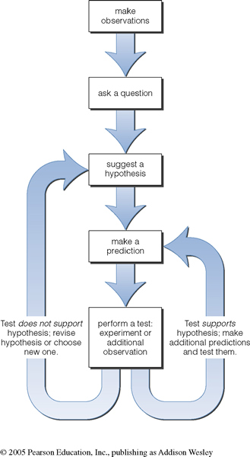
Ideal scientific method
Based on proposing and testing hypotheses
Hypothesis = educated guess
Testing is crucial

Slide 6
More realistically:
What are some questions
I can actually answer?
Can take many tries to pose a sensible one
In astronomy, frequently a “post-diction”
Test results can
be ambiguous

Slide 7
But science doesn’t always proceed in this idealized way!
Sometimes we start by “just looking” and then coming up with possible explanations.
Sometimes we follow our intuition rather than a particular line of hard evidence.
There are frequently several blind alleys that don’t work out, before a successful theory is developed and tested.
But in the end, a theory must be tested against experiment
Notes:
E.g., Copernicus and his early backers did NOT have a model that worked better than the Earth-centered model, but their intuition kept them working at it until Kepler finally found a way to make it work.

Slide 8
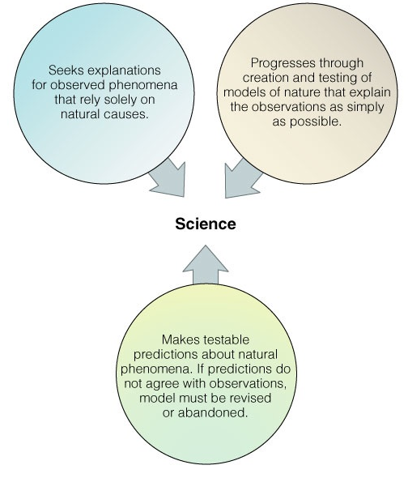
Hallmarks of science
Useful criteria to decide whether an argument is scientific or not

Slide 9
Hallmarks of Science: #1
In ancient times, actions of the gods were invoked as explanations for things that were hard to understand
But modern science seeks explanations for observed phenomena that rely solely on natural causes
Other kinds of explanations don’t come under the heading “science”, but rather are different kinds of discussions
Notes:
Example: Kepler sought a natural explanation for observations made by Tycho.

Slide 10
Hallmarks of Science: #2
Science progresses through the creation and testing of models of nature that explain the observations as simply as possible.
Example: By early 1600s, there were several competing models of planetary motion (Ptolemy, Copernicus, Kepler, …) Kepler’s gained acceptance because it worked the best when compared with the latest data.
Notes:
Example: By early 1600s, we several competing models of planetary motion, including those of Ptolemy, Copernicus, and Kepler. Kepler’s gained acceptance because it worked the best. Also: in principle, we could make a geocentric model arbitrarily accurate with enough circles, but its lack of simplicity would still lead us to prefer Kepler’s model…

Slide 11
Hallmarks of Science: #3
A scientific model should make testable predictions about natural phenomena.
If subsequent tests don’t agree with the predictions, a scientist would be willing (even eager) to revise or even abandon his/her model.
If someone, in the face of data that contradict his/her model, isn’t willing to revise or abandon it, they are not using the scientific method.
Notes:
Example: each of the competing models offered predictions that were tested. Kepler’s model can still be tested. In fact, slight discrepancies found at later dates led to new discoveries, such as Einstein’s theories…

Slide 12
Issues for Planetary Science
Planets and their moons are hugely varied
For example: We aren’t advanced enough to have an a priori theory that would predict what a newly discovered moon of Jupiter or Saturn should be like
“Retrodiction” or “postdiction” rather than “prediction”
  Try to understand new observations using general principles based on previous body of data

Slide 13
What about astrology?
How is astrology different from astronomy?
Is astrology a scientific theory?
Does astrology have scientific validity?

Slide 14
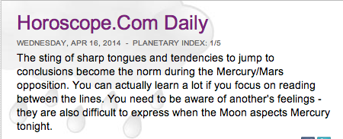
Astrology asks a different type of question than astronomy
Astronomy is a science focused on learning about how stars, planets, and other celestial objects work.
Astrology is a search for hidden influences on human lives based on the positions of planets and stars in the sky.

Slide 15
Does astrology have scientific validity?
In principle the stars might influence human affairs.
Scientific tests consistently show that astrological predictions are no more accurate than we should expect from pure chance.
Proponents of astrology say that the act of doing controlled experiments ruins the “aura” and that’s why predictions aren’t accurate when tested in a lab.
In my opinion this means that astrology doesn’t come under the heading “science”, since it can’t (or won’t) make testable predictions.

Slide 16
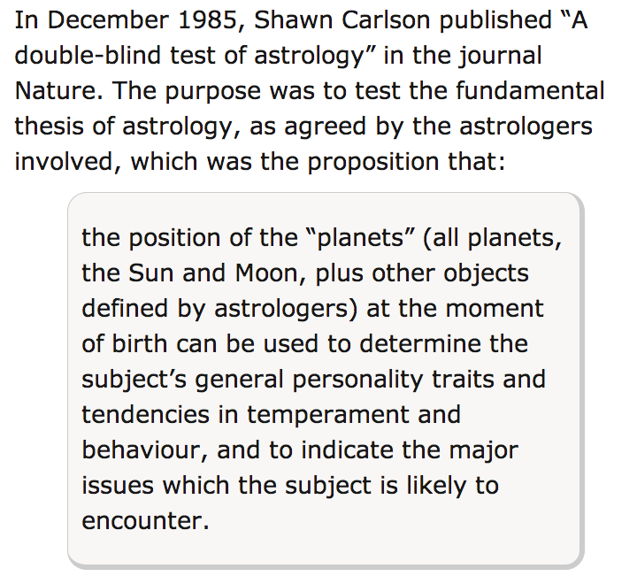
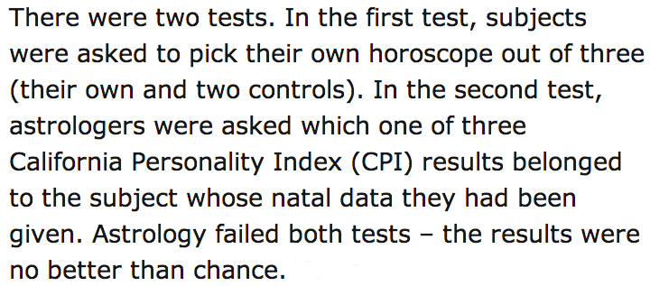
http://skeptico.blogs.com/skeptico/2007/06/testing-astrolo.html

Slide 17
What have we learned?
A scientific theory should:
  Explain wide variety of observations with a few simple principles,
  Be supported by a large, compelling body of evidence,
  Must not have failed crucial tests of its validity,
  Be amenable to modification if new data require this.
Astrology
  Search for hidden influences on human lives based on the positions of planets and stars
  Thus far scientific tests show that astrological predictions are no more accurate than we should expect from pure chance

Slide 18
Light: The Main Points
Most of what we know about the universe comes to us in the form of light
The visible light that our eyes can see is only a small part of the electromagnetic spectrum
  Also radio waves, infrared light, ultraviolet light, x-rays, gamma-rays
By spreading light out into different “colors” (taking a spectrum) we can learn about the physical conditions of the light-emitter and of intervening material
  Composition, temperature, motion toward or away from us, rotation rate, atmospheric structure, ....

Slide 19
Light and Matter: Outline
Much of what we have learned about the universe is based on observing light, and understanding how it has interacted with matter
Properties of light
Properties of matter
How light interacts with matter

Slide 20
How do we experience light?
The warmth of sunlight tells us that light is a form of energy!
We measure the flow of energy in light in units of watts: 1 watt = 1 joule/s.

Slide 21
How do light and matter interact?
Emission
Absorption
Transmission
  Transparent objects transmit light.
  Opaque objects block (absorb) light.
Reflection/scattering

Slide 22
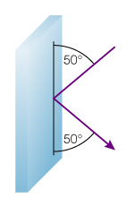
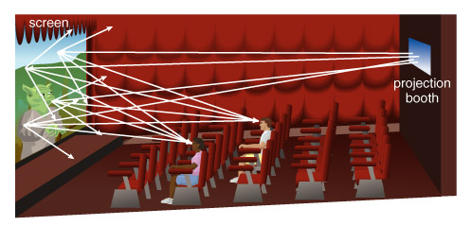
Reflection and Scattering
Movie screen scatters light in all directions
Mirror reflects light in a particular direction

Slide 23
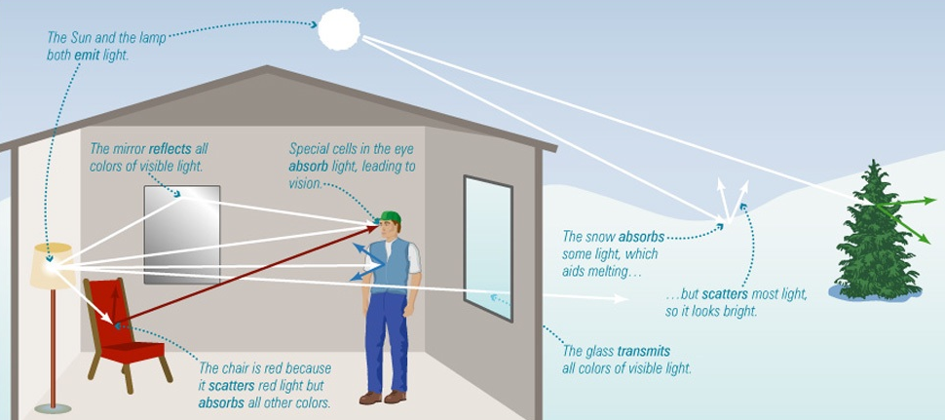
Interactions of Light with Matter
Interactions between light and matter determine the appearance of everything around us

Slide 24
What is light?
Light can act either like a wave or like a particle.
Particles of light are called photons.

Slide 25
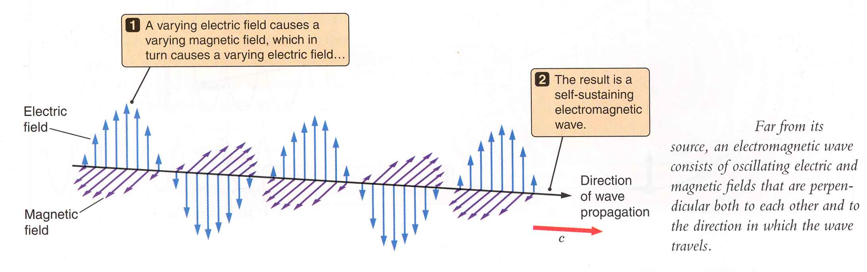
What is light?
Oscillating electric and magnetic fields, traveling at “speed of light” (300,000 km/sec)

Slide 26
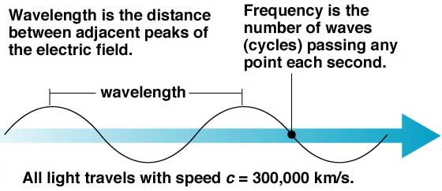
Light can be described as a wave
Wave: a periodic disturbance that travels through space and time
  Wavelength λ (e.g. meters)
  Frequency f (cycles per sec or Hertz)
  Propagation speed c (e.g. meters / sec)

Slide 27
Anatomy of a Wave

Slide 28
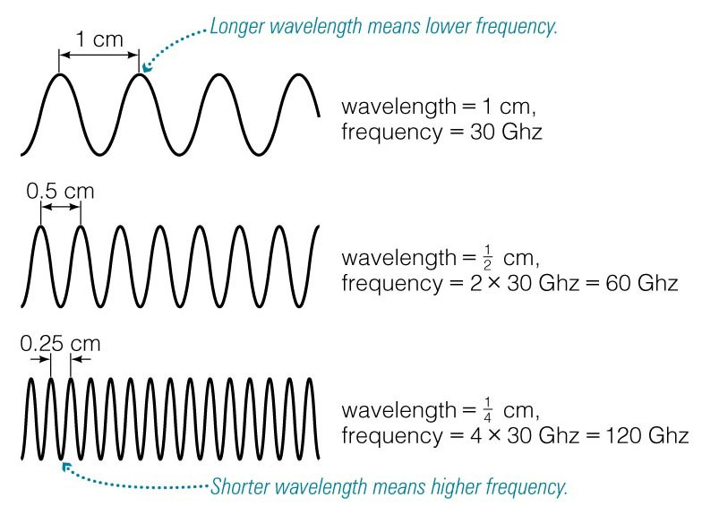
Wavelength visualized

Slide 29
Relation between frequency and wavelength of a light wave
If a wave oscillates f times a second, its frequency is f cycles per sec or Hertz
Period of a wave is time for two crests to pass a given point in space: P = 1 / f sec
Relation between frequency f and wavelength λ

Slide 30
Units of frequency and wavelength

Slide 31
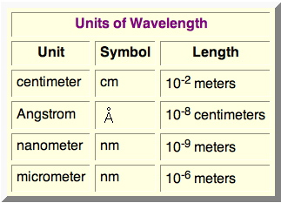
Units used for wavelength
micron
μm

Slide 32
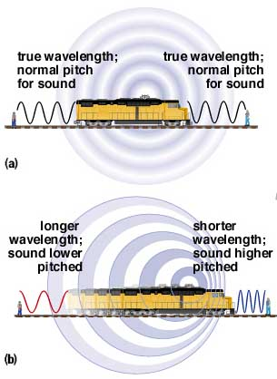
Doppler shift: a moving object can change frequency of emitted or reflected waves
Sound waves:
Stationary
Moving

Slide 33
Hearing the Doppler Effect
Notes:
Turn on sound

Slide 34
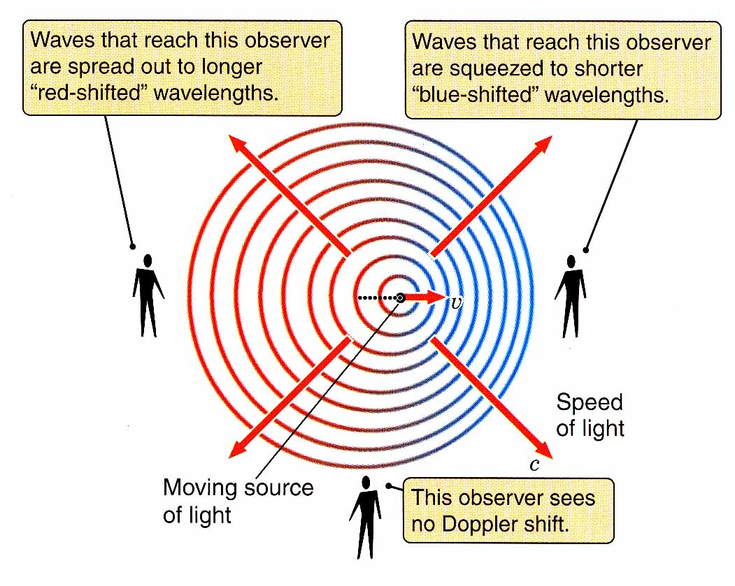
Doppler shift: a moving object can change frequency of emitted or reflected waves
Light waves:

Slide 35
Size of Doppler shift depends on speed v

Slide 36
Example of Doppler shift
The “rest wavelength” of light being emitted by a planet is 6562.85 Å, and we observe this light to be shifted to a wavelength of 6562.55 Å
What velocity does light’s source have?

Slide 37
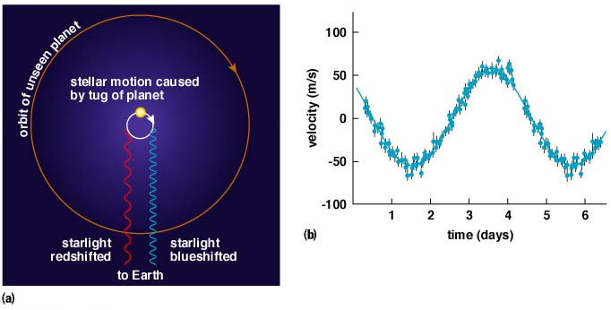
Extrasolar planets: one method of detection relies on Doppler shift

Slide 38
Concept Question
Which of the following are ways to detect the velocity of a star towards us or away from us?
  taking photographs 6 months apart
  applying the inverse square law of brightness
  measuring the shift in wavelength of its light
  measuring the shift in distance of the star

Slide 39
Light as a particle: photons
A paradox: light behaves both as a particle and as a wave!
Just as a baseball carries a specific amount of kinetic energy, each light particle or “photon” of light carries a specific amount of radiative energy:

Slide 40
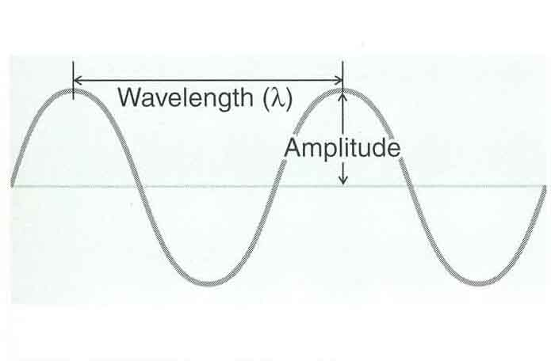
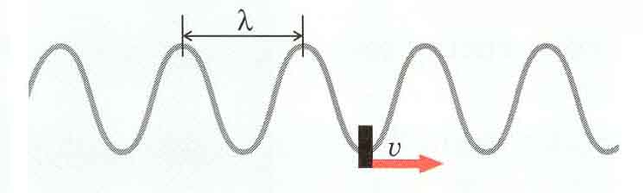
Distinguish between light energy and light intensity
Higher amplitude and intensity
  Intensity is just square of amplitude
Higher frequency and photon energy

Slide 41
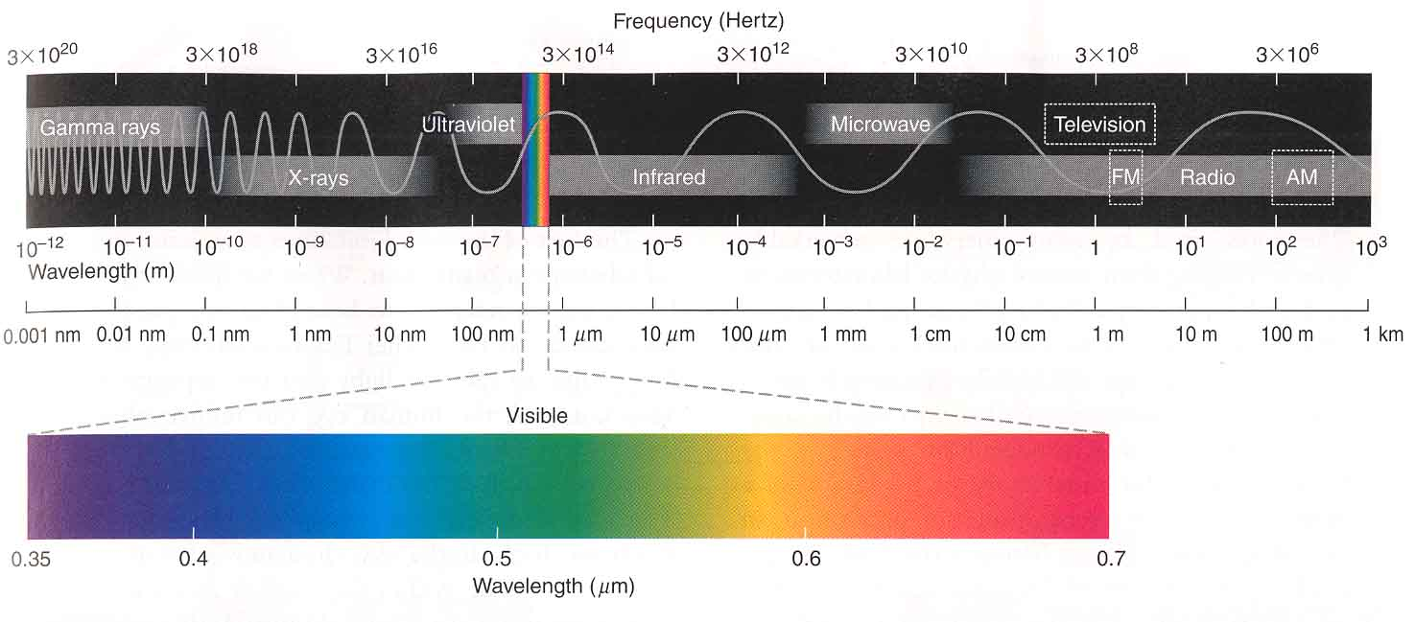
Visible light is only a small fraction of the electromagnetic spectrum

Slide 42
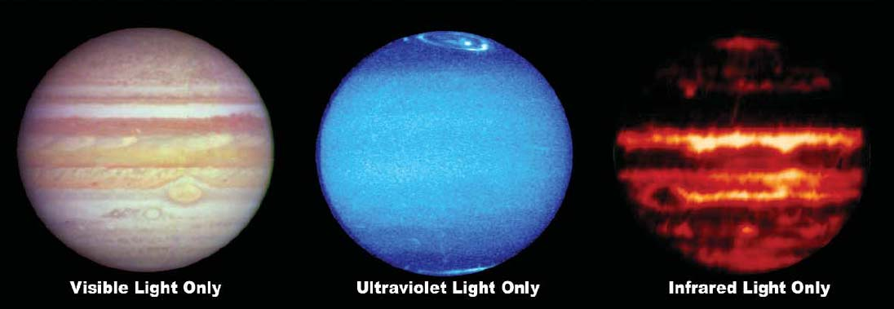
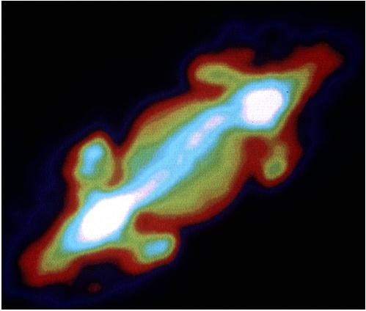
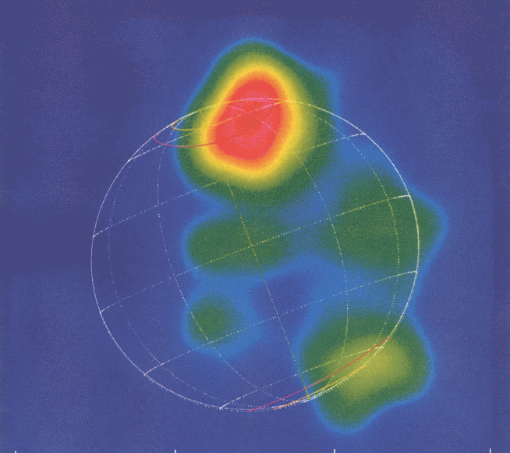
Jupiter at many wavelengths: Each tells us something different about the planet
xrays
radio waves

Slide 43
What have we learned?
What is light?
  Light can behave like either a wave or a particle.
  A light wave is a vibration of electric and magnetic fields.
  Light waves have a wavelength and a frequency.
  Photons are particles of light.
What is the electromagnetic spectrum?
  Human eyes cannot see most forms of light.
  The entire range of wavelengths of light is known as the electromagnetic spectrum.

Slide 44
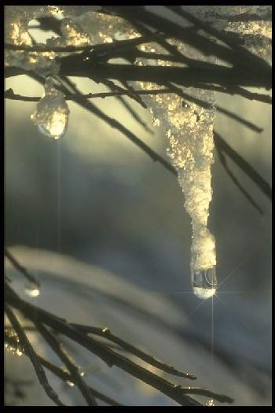
Properties of Matter
What is the structure of matter?
What are the phases of matter?
How is energy stored in atoms?

Slide 45
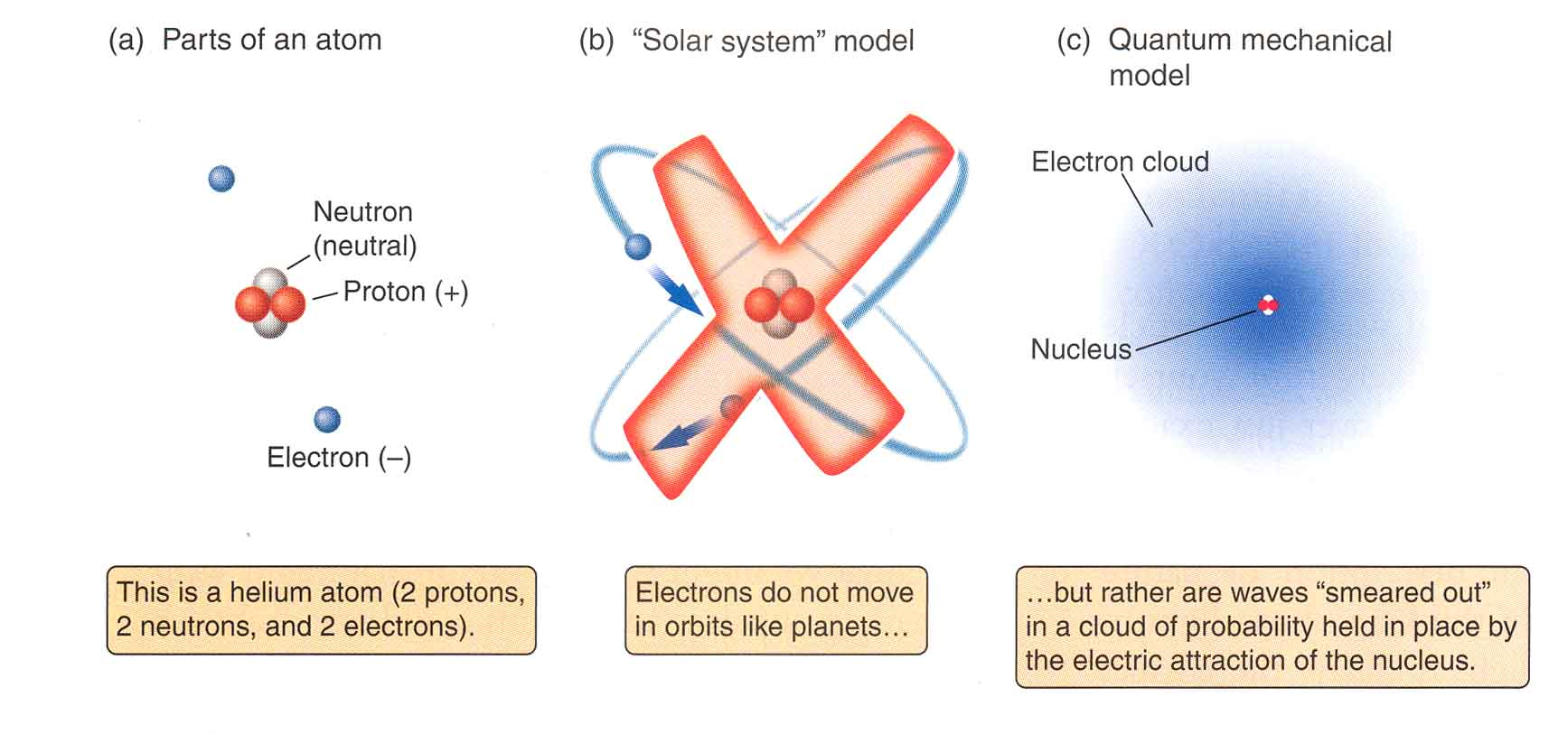
Atomic structure

Slide 46
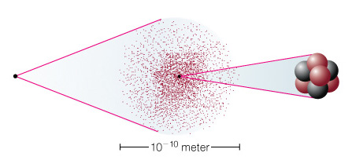
What is the smallest-structure of matter?
Electron
cloud
Electron
Cloud
Nucleus
Nucleus
(protons and neutrons)
Atom
Notes:
Use this figure to define the nucleus; protons, neutrons, electrons; scale of atom and “electron cloud.”

Slide 47
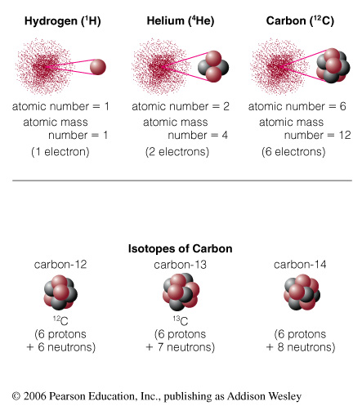
Atomic Number and Mass
Atomic Number = # of protons in nucleus
Atomic Mass Number = # of protons + neutrons
Molecules: consist of two or more atoms (H₂O, CO₂)

Slide 48
Atomic Terminology
Isotope: same # of protons but different # of neutrons. (⁴He, ³He)
All are carbon: 6 protons, atomic number 6

Slide 49
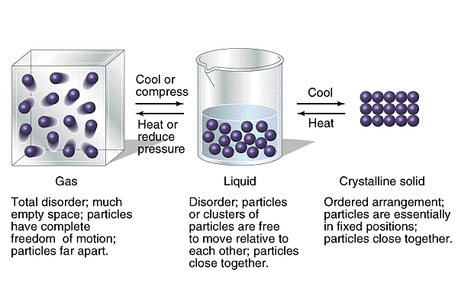
Solids, liquids, gases are different phases of matter
Matter is made of atoms and molecules (groups of atoms)

Slide 50
Properties of Matter
What are the phases of matter?
How is energy stored in atoms?
What makes matter change from one phase to another?

Slide 51
All three phases have random motions
Temperature and phases of water

Slide 52
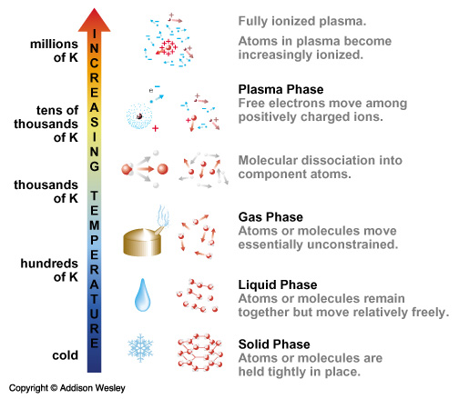

Slide 53
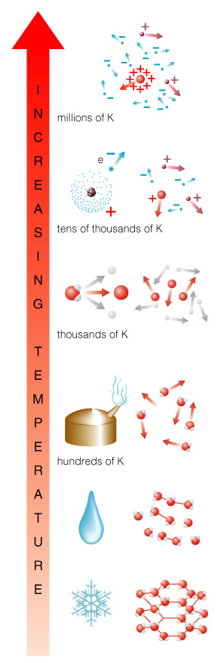
Phase Changes: Terminology
Ionization: Stripping of electrons, changing atoms into plasma
Dissociation: Breaking of molecules into atoms
Evaporation: Breaking of flexible chemical bonds, changing liquid into gas
Melting: Breaking of rigid chemical bonds, changing solid into liquid

Slide 54
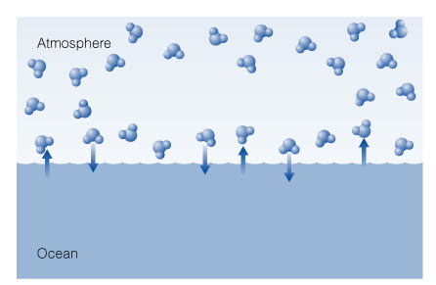
Phases and Pressure
Phase of a substance depends on both temperature and pressure
Often more than one phase is present

Slide 55
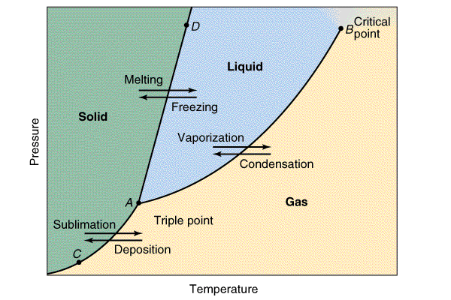
Phase Diagram: plots pressure against temperature
Phase of a substance depends on both temperature and pressure
Above critical point, gas makes continuous transition to liquid
No phase transition
Happens inside the giant planets

Slide 56
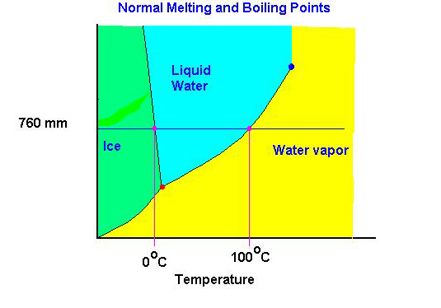
Phase Diagram: plots pressure against temperature
Phase of a substance depends on both temperature and pressure
atmospheric pressure
Pressure

Slide 57
Concept Question
Can you use the phase diagram below to show that a pressure cooker makes boiling water hotter than 100 ºC?
atmospheric pressure
Pressure

Slide 58
How can light tell us about the physical conditions of its source?
Emission of light by matter
Absorption of light by matter

Slide 59
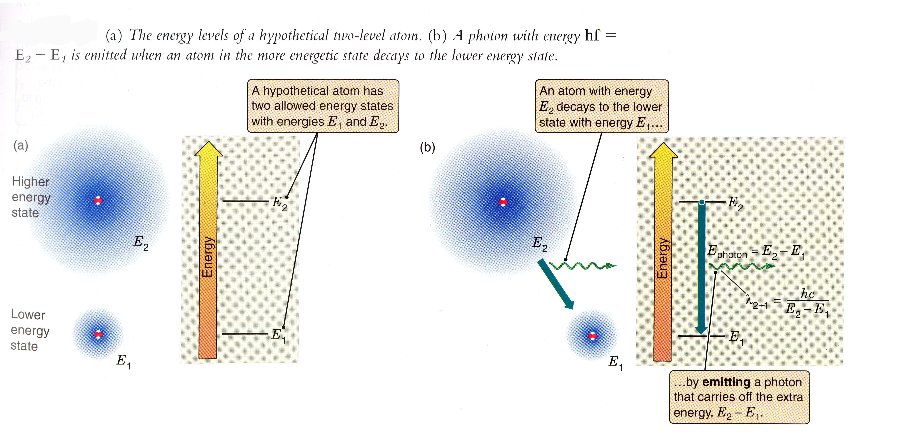
Emission of light by an atom

Slide 60
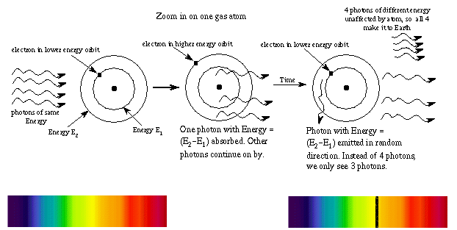
Absorption of light by an atom
© Nick Strobel

Slide 61
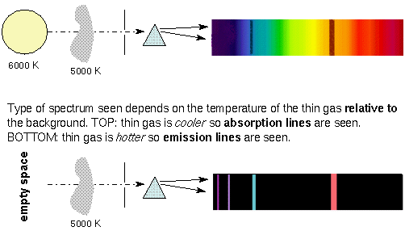
Emission and absorption lines
© Nick Strobel

Slide 62
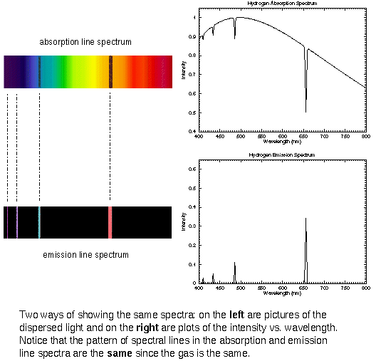
Scans of a spectrum

Slide 63
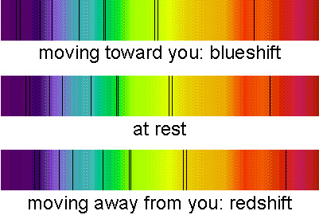
Doppler shift of a spectrum

Slide 64
Concept Question
If we observe one edge of a planet to be redshifted and the opposite edge to be blueshifted, what can we conclude about the planet?
The planet is in the process of formation.
We must actually be observing moons orbiting the planet in opposite directions, not the planet itself.
The planet is in the process of falling apart.
The planet is rotating.

Slide 65
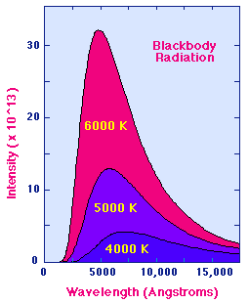
“Blackbody radiation” - spectrum of light emission due to temperature

Slide 66
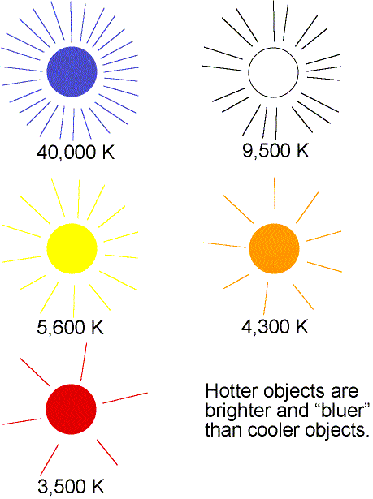
Bluer color emitted light means hotter temperature of the matter
© Nick Strobel

Slide 67
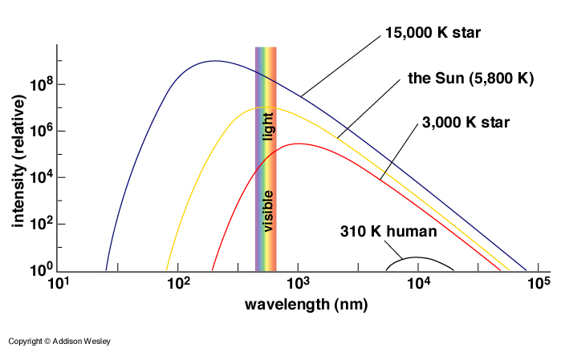
Total flux emitted by a body at temperature T

Slide 68
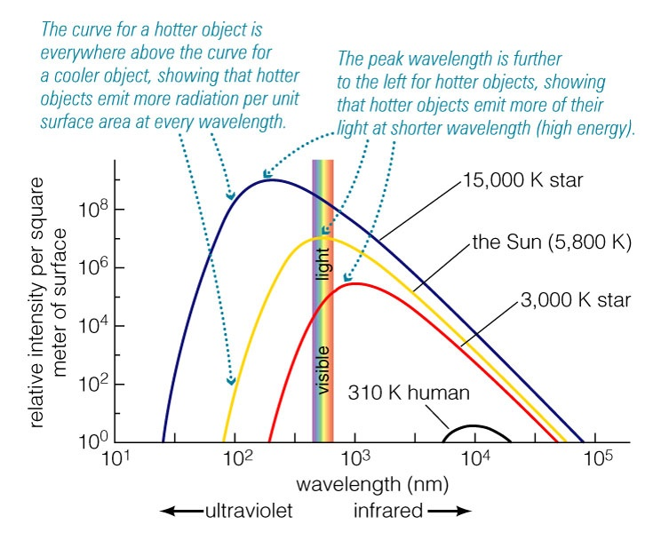
Total flux emitted by a body at temperature T
Wien’s Law

Slide 69
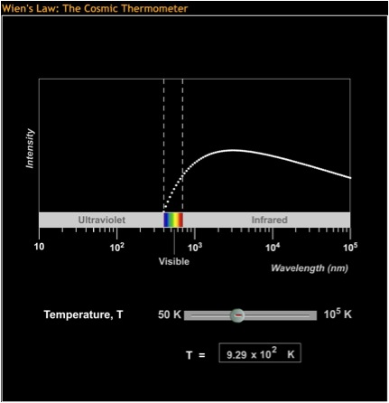
Wien's Law
Notes:
Remind students that the intensity is per area; larger objects can emit more total light even if they are cooler.

Slide 70
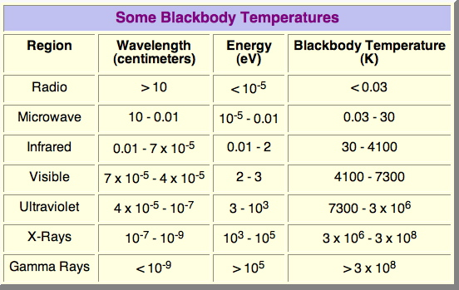
Wavelengths of peak emission, from radio to gamma ray wavelengths

Slide 71
Concept Question
A star with a continuous spectrum shines through a cool interstellar cloud of hydrogen gas. The cloud is falling inward toward the star. Which best describes the spectrum seen by an Earthbound observer?
  blueshifted hydrogen emission lines
  blueshifted hydrogen absorption lines
  redshifted hydrogen emission lines
  redshifted hydrogen absorption lines
  a redshifted hydrogen continuum
Hint: Try drawing a sketch

Slide 72
Some things you can learn from a spectrum
Temperature and density of matter at the light source
Ionization state
Chemical composition
  Example: ozone as sign of life on Earth
Presence of specific minerals
  Example: Lunar Prospector spacecraft, ice on moon
Structure of atmosphere
  Example: Neptune clouds, height of cloud layers
Velocities of the material emitting or absorbing the light

Slide 73
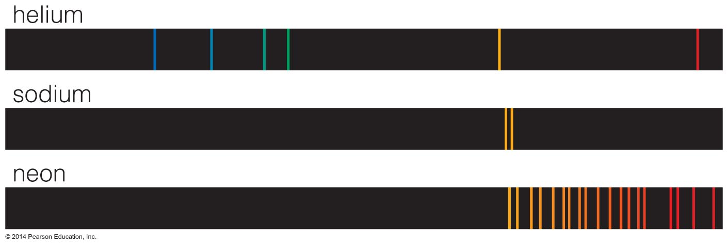
Chemical Fingerprints from Emission Lines
Wavelength of light
Each type of atom has a unique spectral fingerprint.

Slide 74
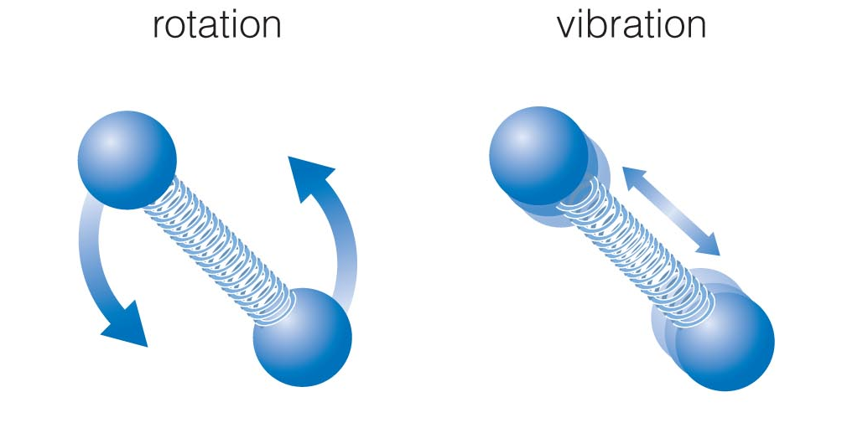
Energy Levels of Molecules
Molecules have additional energy levels because they can vibrate and rotate.

Slide 75

Energy Levels of Molecules
Wavelength of light
The large numbers of vibrational and rotational energy levels can make the spectra of molecules very complicated.
Many of these molecular transitions are in the infrared part of the spectrum.

Slide 76
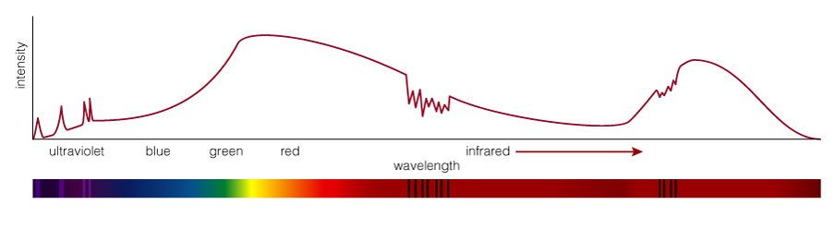
What is this object?
Reflected Sunlight: Continuous spectrum of visible light is like the Sun’s except that some of the blue light has been absorbed - object must look red

Slide 77
What is this object?
Thermal Radiation: Infrared spectrum peaks at a wavelength corresponding to a temperature of 225 K

Slide 78
What is this object?
Carbon Dioxide: Absorption lines are the fingerprint of CO₂ in the atmosphere

Slide 79
What is this object?
Ultraviolet Emission Lines: Indicate a hot upper atmosphere

Slide 80
What is this object?
Mars!

Slide 81
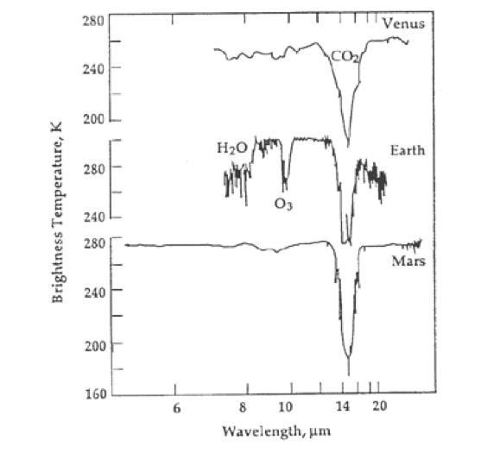
Spectral signatures of life on Earth
Venus and Mars (no life today): CO₂
Earth today: has water (H₂O), and atmospheric composition has been altered by life
  Ozone line (O₃)
  Water line (H₂O)

Slide 82
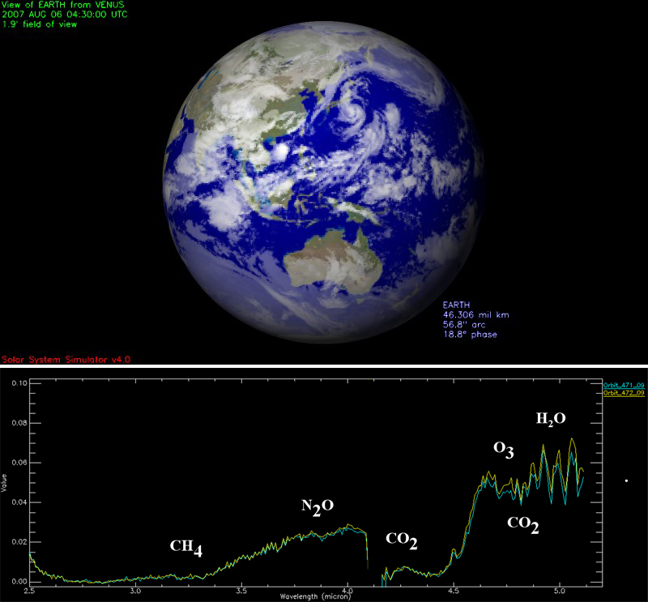
Spectrum of Earth seen from Venus Express Spacecraft

Slide 83
The Main Points
Most of what we know about the universe comes to us in the form of light
The visible light that our eyes can see is only a small part of the electromagnetic spectrum
  Also radio waves, infrared light, ultraviolet light, x-rays, gamma-rays
By spreading light out into different “colors” (taking a spectrum) we can learn about the physical conditions of the light-emitter and of intervening material
  Composition, temperature, motion toward or away from us, rotation rate, minerals on surface, atmospheric structure, ....

